Slide 1

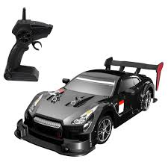
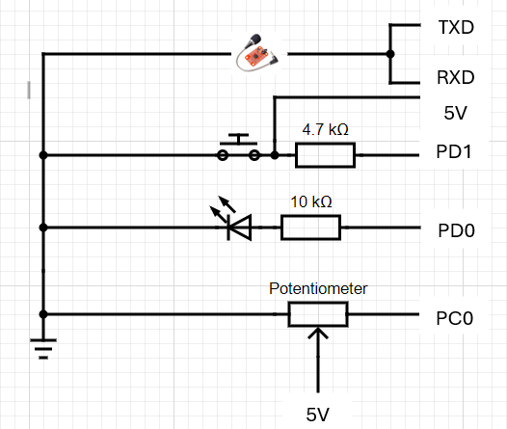
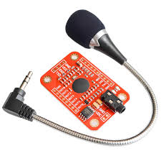
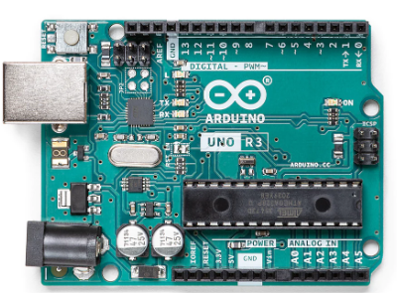
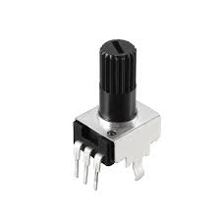
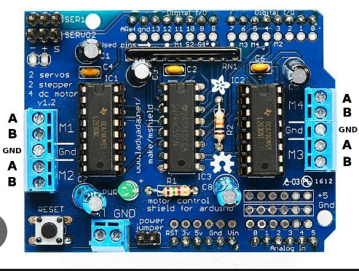
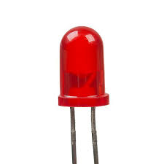
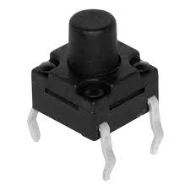

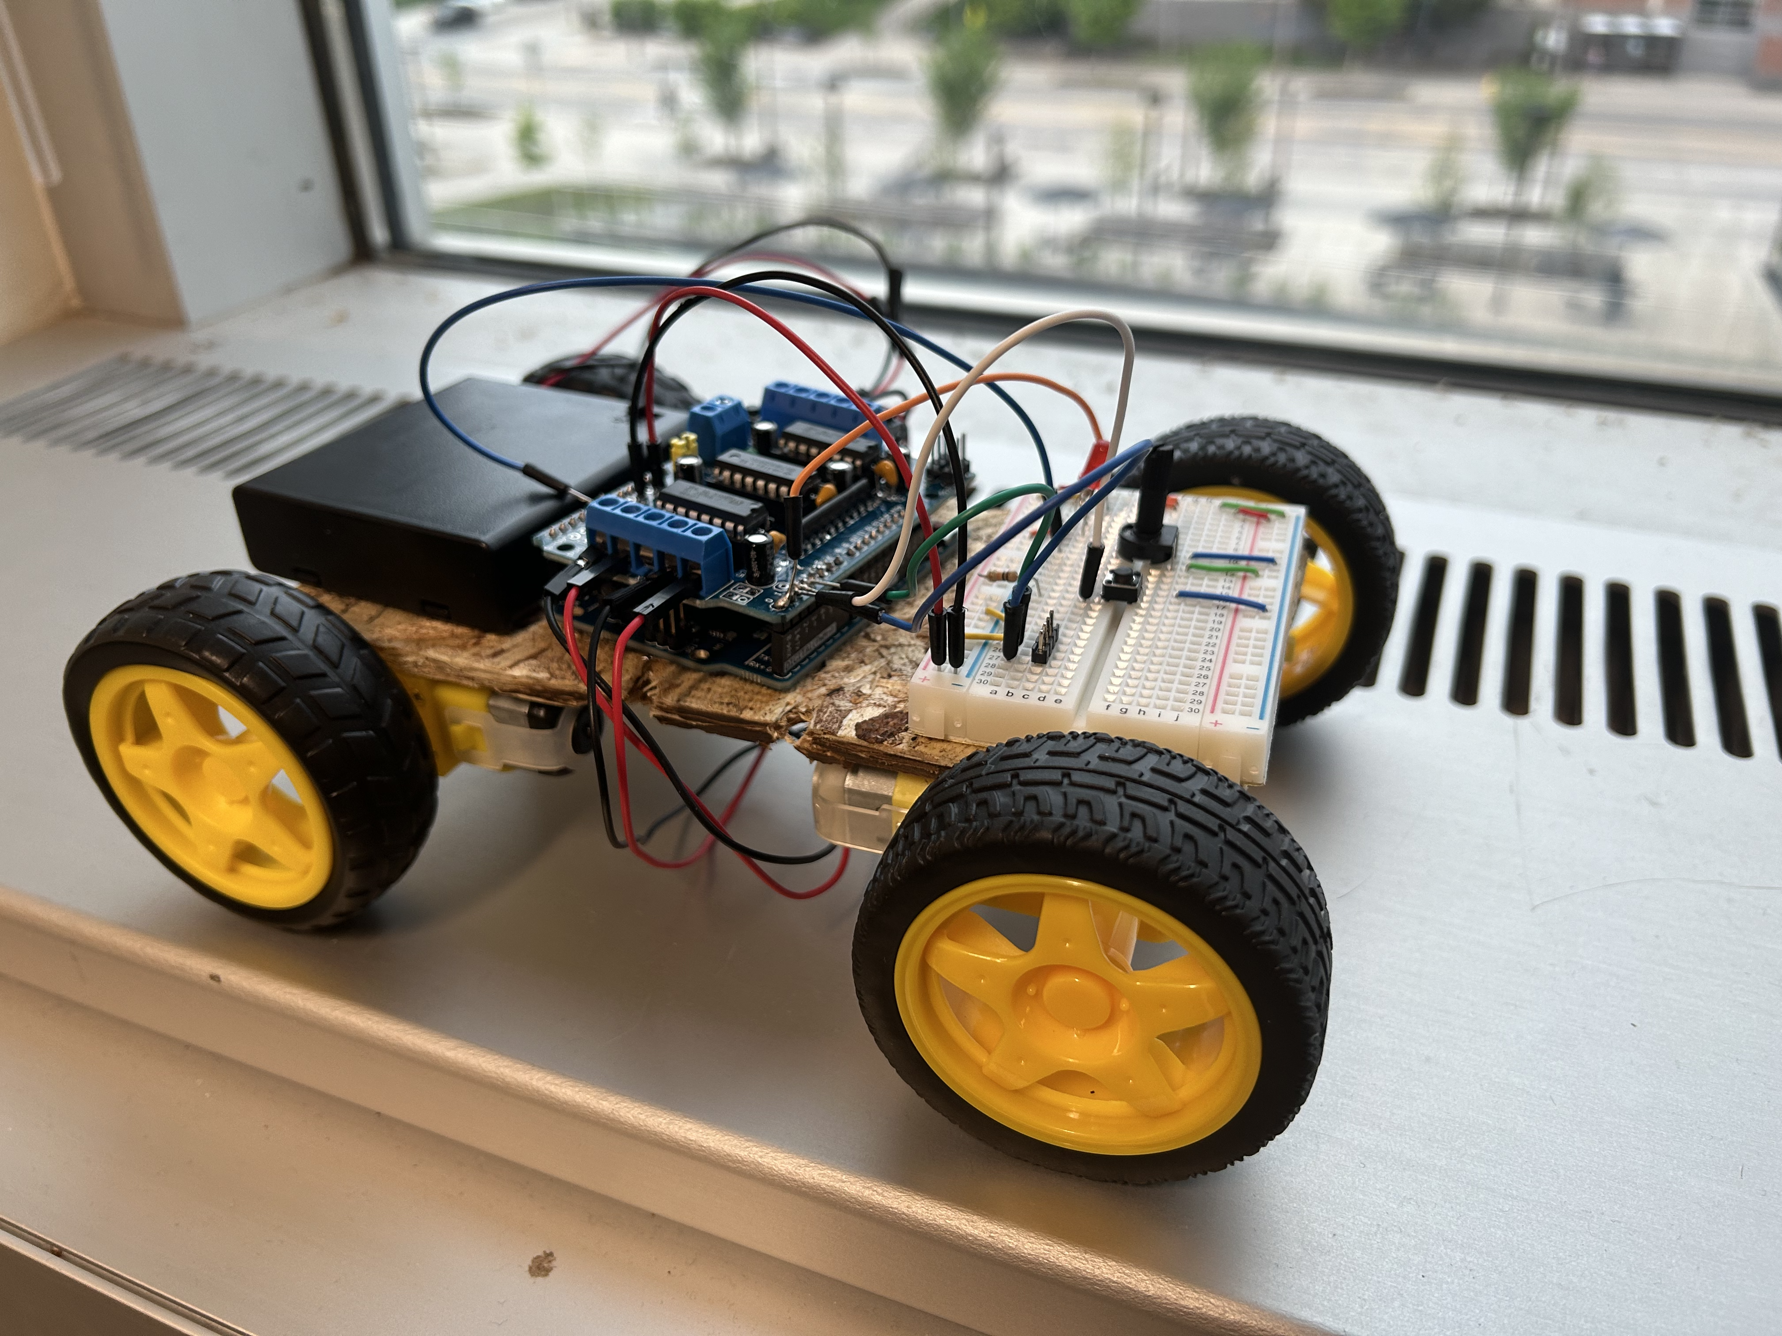
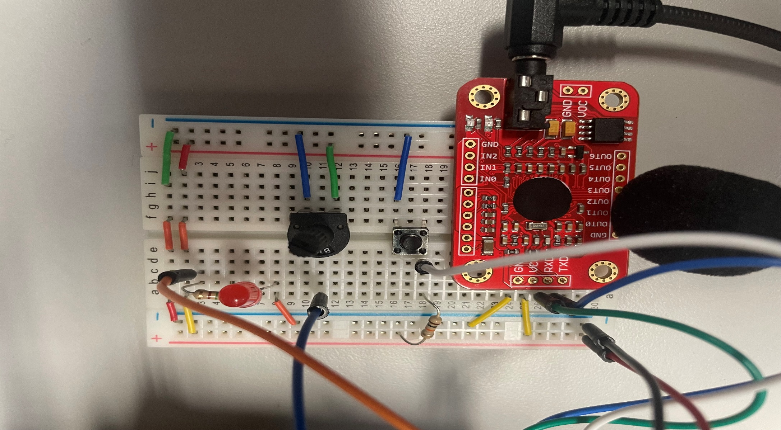
Voice Controlled Automobile
Team Members: Matt Stensby, Shaun Richter
Abstract
Our project introduces a voice-controlled miniature car, achieved through a blend of embedded systems and advanced software development. Our embedded software enables control over the car’s movements, facilitating forward motion, turning, and stopping. Additionally, a potentiometer was integrated to control the cars speed dynamically. A push button determines the mode which is depicted by an LED. By seamlessly integrating speech-to-text capabilities, users can dictate movement of the car using verbal commands.
Introduction
Our device reimagines the classic Remote-Controlled Car experience by seamlessly integrating voice control technology in place of a traditional controller. Users can direct the car’s movement using only their voice, eliminating the need for a physical remote controller.
We’ve crafted a user-friendly voice-controlled car with five key commands: forward, backward, left, and stop. Once the voice recognition module accurately interprets a command, the car promptly responds by moving in the corresponding direction. Our design simplifies the setup by requiring AA batteries solely for the car.
Caption: Our device was inspired by a Remote-Controlled toy such as this one.
Shown are the major components of the system. The Arduino Uno(1) serves as the system’s core controller, powered by batteries(3) for mobility. Through PWM, it manages speed by adjusting the duty cycle and controls motor direction via the motor driver(2). A potentiometer(5) fine-tunes wheel speed, while a mode-select button(7) toggles between demo and normal mode, the former running the motors for two seconds before stopping and the latter operating until commanded otherwise. An LED(6) indicator reflects the current mode, off for demo and on for normal, ensuring intuitive user interaction and precise control over the car’s movements. The car’s movements is determined by the user’s verbal commands through the voice recognition module(4).
System Description
(4)
(2)
(1)
(5)
(6)
(7)
(3)
Results
Caption: Photograph of complete embedded voice-controlled car
Caption: Photograph of user input/interaction components
Lessons Learned
Conclusion
Throughout this project, we explored essential elements of embedded system engineering such as Pulse Width Modulation(PWM) for speed regulation, the functionality of potentiometers and utilization of ADC voltage through the potentiometer. Soldering emerged as a pivotal skill, enabling us to seamlessly integrate all components of the car into a unified embedded system. The most important lesson we learned is to NOT solder will the Arduino is powered!
Our exploration into Embedded Systems was both enlightening and enjoyable, particularly with the integration of advanced features such as voice control, which enriched our project. Future implementations and improvements of this system is debouncing the voice recognition to work in my diverse sound environments. We would like to thank the Science Buddies(Voice Recognition Assistance) and Professor Kruger.
References
Science Buddies YouTube: https://www.youtube.com/@Science.Buddies
Speak Recognition, Voice Recognition Module Data Sheet: https://www.elechouse.com/elechouse/images/product/VR3/VR3_manual.pdf
Adafruit Motor Shield Data Sheet: https://cdn-learn.adafruit.com/downloads/pdf/adafruit-motor-shield-v2-for-arduino.pdf
Embedded Systems 2024
The University of Iowa

